Slide 1
How to do a literature search?
Using the Faculty of Economics and Business in Rijeka Library Catalog

Slide 2
How to do a literature search?
Go to the Faculty’s website http://www.efri.uniri.hr
Select Life et EFRI - Library from the navigation menu, and Library Services from the drop-down menu
To search the library fund, click Search the Catalog

Slide 3
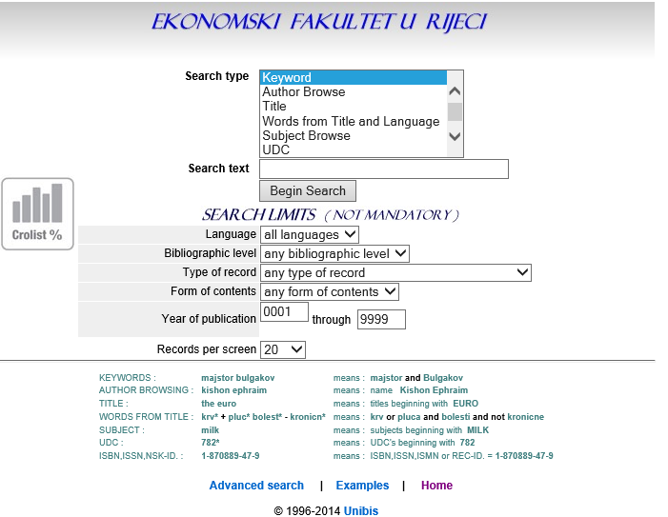
SEARCH INTERFACE
From the drop-down menu, select what you want to search for: keyword, author browse, title… Enter the text and click
BEGIN SEARCH

Slide 4
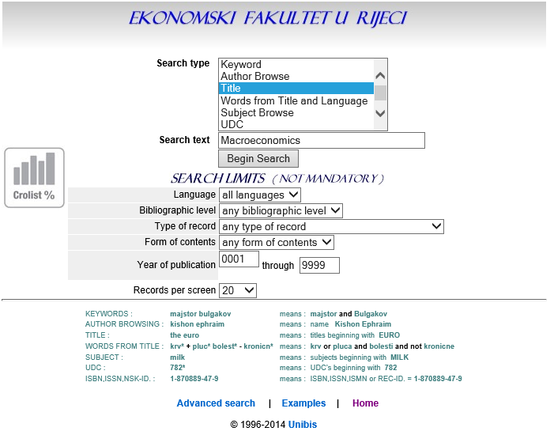
Example:
Enter the title
Begin Search

Slide 5
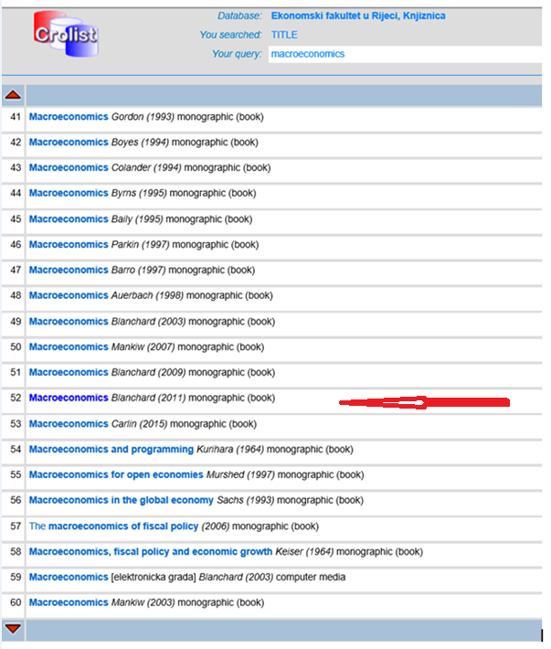
Select the title

Slide 6
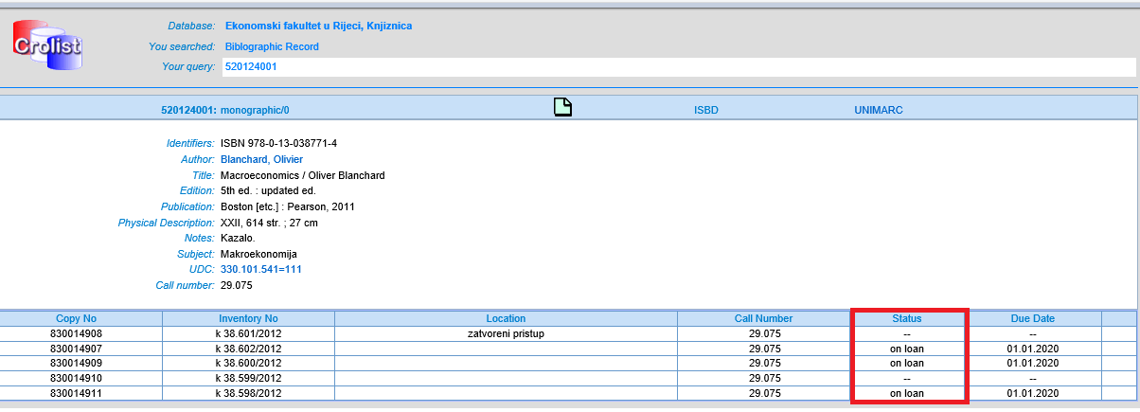
The title you have selected will be opened in a window like this. Here you can find the basic information about the book and its status: whether it is on loan or free.

Slide 7
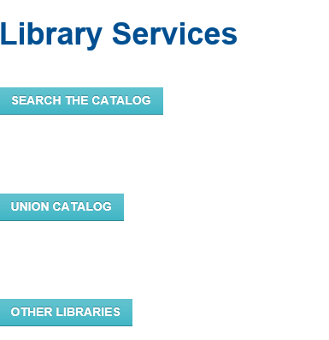
If the literature you need is not available at the Faculty’s Library, you can do a literature search in other libraries or in the union catalog

Slide 8
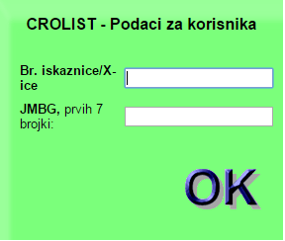
USER DATA
To check your user data (borrowed books, overdue fines, notices), select the User Data icon

Slide 9
DATABASES
Databases available on the University of Rijeka website Electronic Resources
https://www.svkri.uniri.hr/index.php/knjiznicni-sustav-
sveucilista/baze-podataka
Portal of electronic resources for the Croatian Academic and Scientific Community (Portal elektroničkih izvora za hrvatsku akademsku i znanstvenu zajednicu)
http://baze.nsk.hr/
Online Database Centre (Centar za online baze podataka) http://onlinebaze.irb.hr/
Online Search Manual (Online priručnik za pretraživanje) http://onlinebaze.irb.hr/prirucnik

Slide 10
DATABASES
- Bibliographic databases – contain information on papers published in various publications with information about the author, the title, summary, the year of publication…
- Citation databases – besides the publications, they provide information on the used literature, references and citations the authors cite at the end of their papers.
Full-text databases – provide insight into the full-text of a certain paper.

